Slide 1
GATOR COMPANION
GRAD 13
DUBEY SAKSHI
GUPTA ANUSHKA
SIKRI RICHA

Slide 2
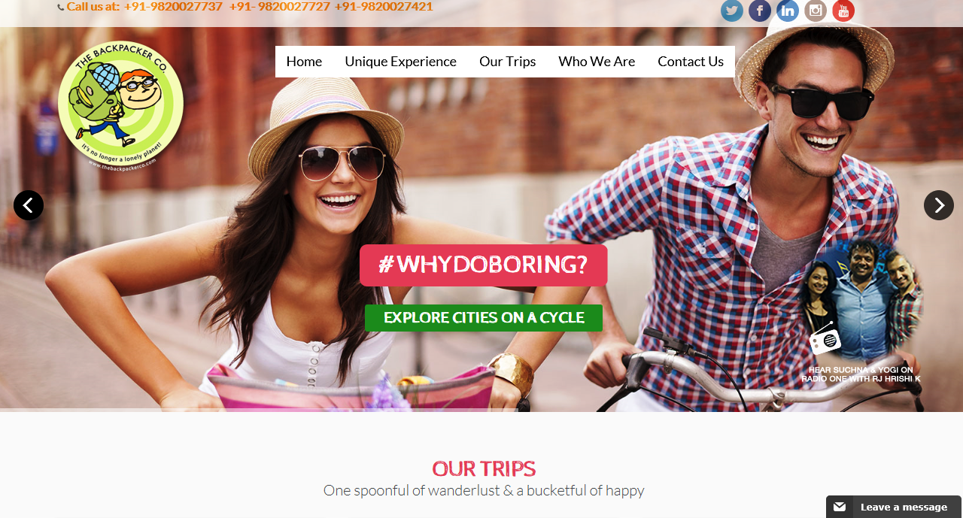
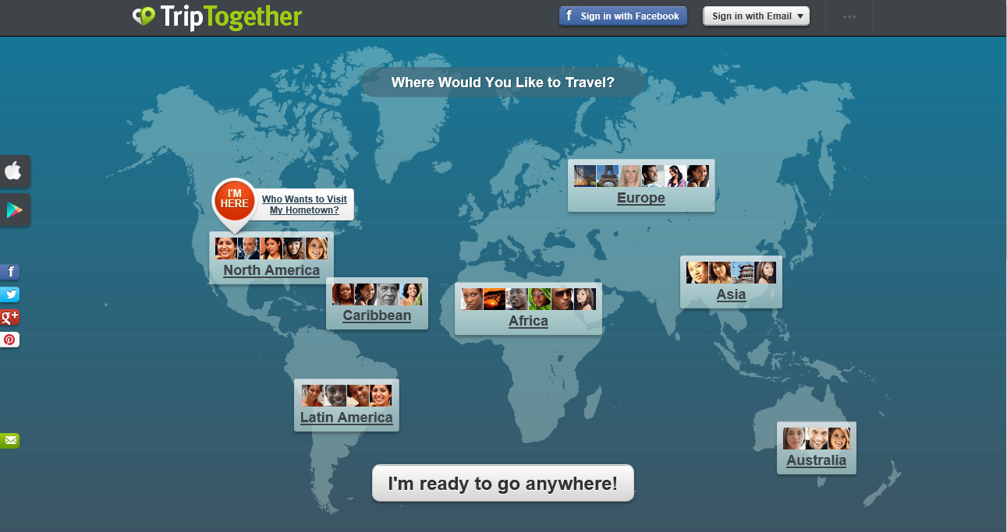
Existing System
BackPackr TripTogether
In BackPackr, one can not update their profile once it’s been made and it is not intuitive as one can not figure out how to proceed.
TripTogether does not let you delete your account and there are a lot of fake profiles thus a major safety concern.

Slide 3
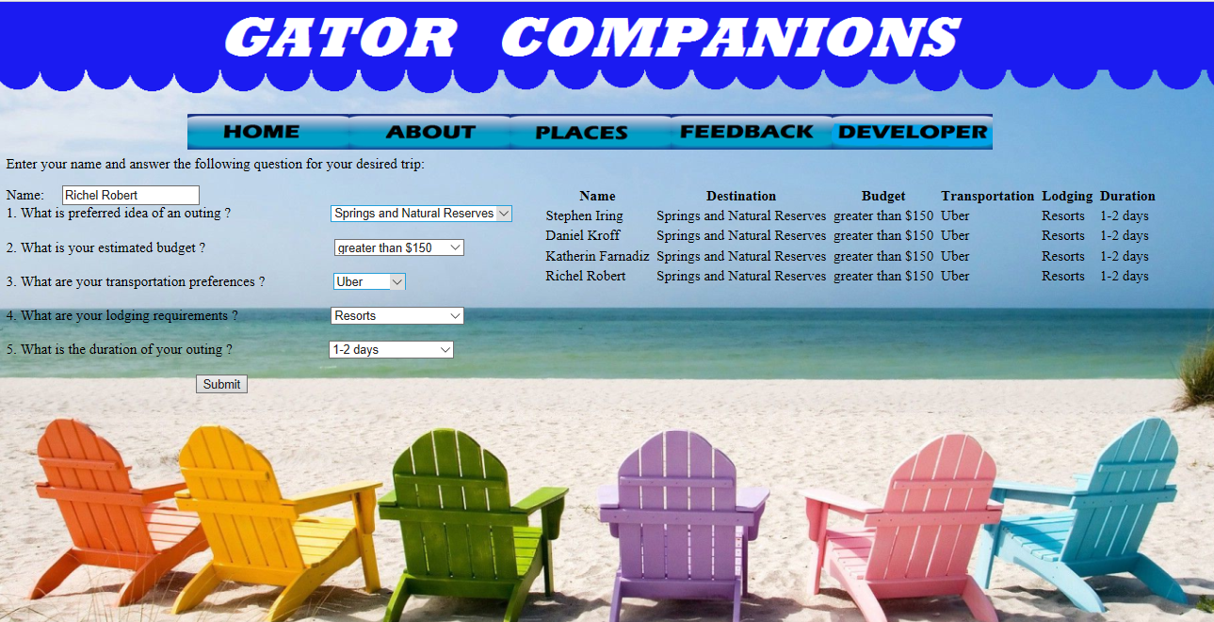
Our System
The Matching Algorithm works perfectly and gives the output of the match instantaneously.
For safety issues we also incorporated the Terms and Conditions agreement before signing up for the application.
The places tab informs the user of various tourist spots already in Gainesville.

Slide 4
User Study Conditions
POPULATION
No. of participants: 32
Target Population: Living in Gainesville for short Duration
Age Group: 20-24 years
Procedure
We explained about our study and asked them to sign the consent form and then let the participants explore our interface and the existing interface
Conducted SUS and Qualtrics Surveys after one week trial period
Interviewed after one week trial period to see if they are actually successful in making trips through our system

Slide 5
Result and Analysis
Primary Hypothesis:The usability rate of our interface for planning trips by a participant will be more than that of existing interface like Backpacker and Trip Together, for planning trips in Gainesville.
Secondary Hypothesis: The different matches found from our interface will be better than the matched suggestions of existing interface like Backpackr and Trip Together for planning trips in Gainesville.
Primary:
 | BackPackr | Gator Companion
Mean | 6.3125 | 7.8125
SD | 1.0906 | 1.7121
Variance | 1.1895 | 2.9314
Secondary: | BackPackr | Gator Companion
Mean | 6.125 | 6.7188
SD | 1.1476 | 1.474
Variance | 1.3171 | 2.173
P (one-tailed) <0.0001
P (Two-tailed) = 0.00110
Accepting Primary Hypothesis & thus rejecting NULL hypothesis!
P (one-tailed) =0.0290
P (two-tailed) = 0.048
Accepting Secondary Hypothesis & rejecting NULL hypothesis!
Since, in the both primary and secondary cases, our p-value is less than 0.05 making it statistically significant and through this we derived the above conclusions regarding hypothesis.

Slide 6
What we learnt How it helps?
Users prefer Gator Companion’s
intuitive and straightforward interface
Experimenting with different interfaces and conducting user testing during each phase with different users is a good decision before finalizing a design, because the effect that the interface have on the user is intense.
HCI Guideline #1: Design should be consistent and analysed using a user’s initial instinct
Thus, we can conclude that people would use Gator Companions more often than the other available applications for planning trips.
A better match would be made available to the users.

